Slide 1
SPRINT 4 DEMO – CCP TOUR APP
Gerardo Flores, Ahram Kim

Slide 2
VISUAL HIERARCHY APP DESIGN
About
default page
Splashscreen
Home
Splash screen for
Boise State University
Computer Science
About
Map
Home
Map

Slide 3


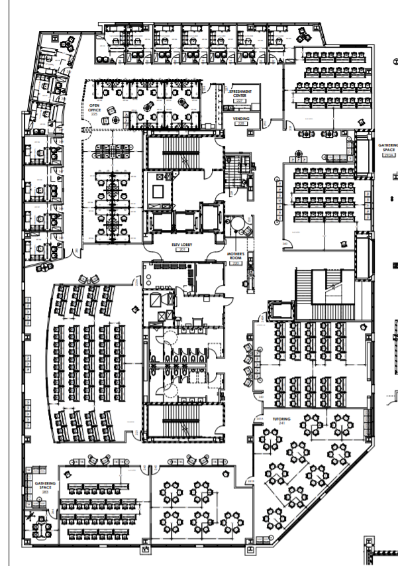


VISUAL HIERARCHY APP DESIGN
Map
CCP 221
2nd floor
2nd floor
3rd floor
Ccp221 INFO
Map
Map
Map
Map

Slide 4
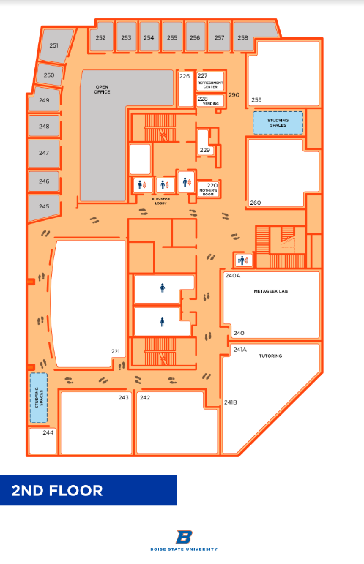
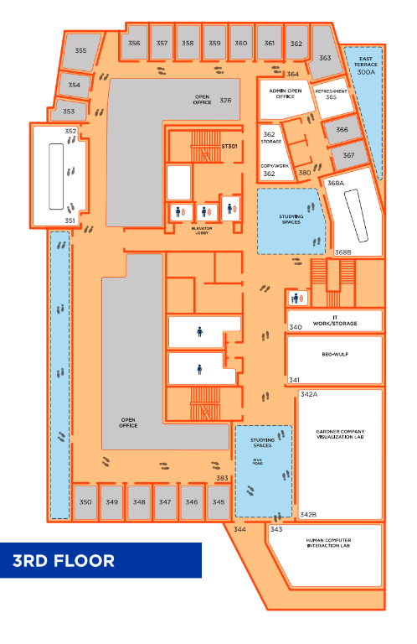
Map

Slide 5

Notes:
This happened because we initialized a new github repo with README or LICENSE file. We should have to merge those new initialized files with our work. ‘git pull’ fetches and merges.

Slide 6
DEFINITION OF DONE
All acceptance criteria have been met
We start the ‘map’ tab for the user
All the automated tests for the user story run without failing and any defects
We have tested to connect to Ionic framework and not found any defects
Code unit tested
Pair programming is done
Build pushed to demo server

Slide 7
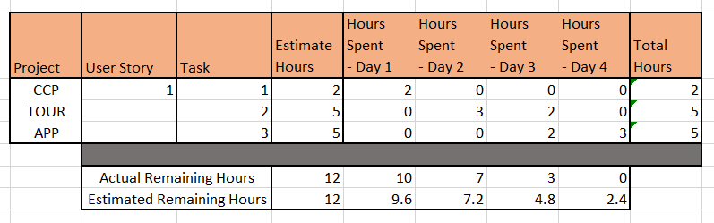
BURNDOWN CHART

Slide 8
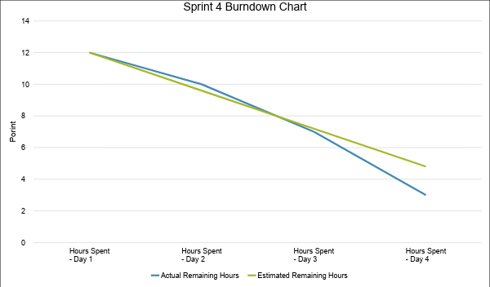
BURNDOWN CHART

